Slide 1
Java JDBC

Slide 2
Introductions to JDBC
JDBC stands for Java Database Connectivity.
JDBC is a Java API to connect and execute the query with the database.
It is a specification from Sun Microsystems that provides a standard abstraction(API or Protocol) for Java applications to communicate with various databases.
It is used to write programs required to access databases. JDBC, along with the database driver, can access databases
The enterprise data stored in a relational database(RDB) can be accessed with the help of JDBC APIs.

Slide 3
Definition of JDBC(Java Database Connectivity)
JDBC is an API(Application programming interface) used in Java programming to interact with databases. The classes and interfaces of JDBC allow the application to send requests made by users to the specified database. The current version of JDBC is JDBC 4.3, released on 21st September 2017.

Slide 4
Purpose of JDBC
Enterprise applications created using the JAVA EE technology need to interact with databases to store application-specific information.
So, interacting with a database requires efficient database connectivity, which can be achieved by using the ODBC(Open database connectivity) driver.
This driver is used with JDBC to interact or communicate with various kinds of databases such as Oracle, MS Access, Mysql, and SQL server database.

Slide 5
Components of JDBC
There are generally four main components of JDBC through which it can interact with a database. They are as mentioned below:
1. JDBC API
2.JDBC Driver manager
3.JDBC Test suite
4.JDBC-ODBC Bridge Drivers

Slide 6
JDBC API: It provides various methods and interfaces for easy communication with the database. It provides two packages as follows, which contain the java SE and Java EE platforms to exhibit WORA(write once run anywhere) capabilities. The java.sql package contains interfaces and classes of JDBC API.
JDBC Driver manager: It loads a database-specific driver in an application to establish a connection with a database. It is used to make a database-specific call to the database to process the user request.
3. JDBC Test suite: It is used to test the operation(such as insertion, deletion, updation) being performed by JDBC Drivers.
4. JDBC-ODBC Bridge Drivers: It connects database drivers to the database. This bridge translates the JDBC method call to the ODBC function call. It makes use of the sun.jdbc.odbc package which includes a native library to access ODBC characteristics.

Slide 7
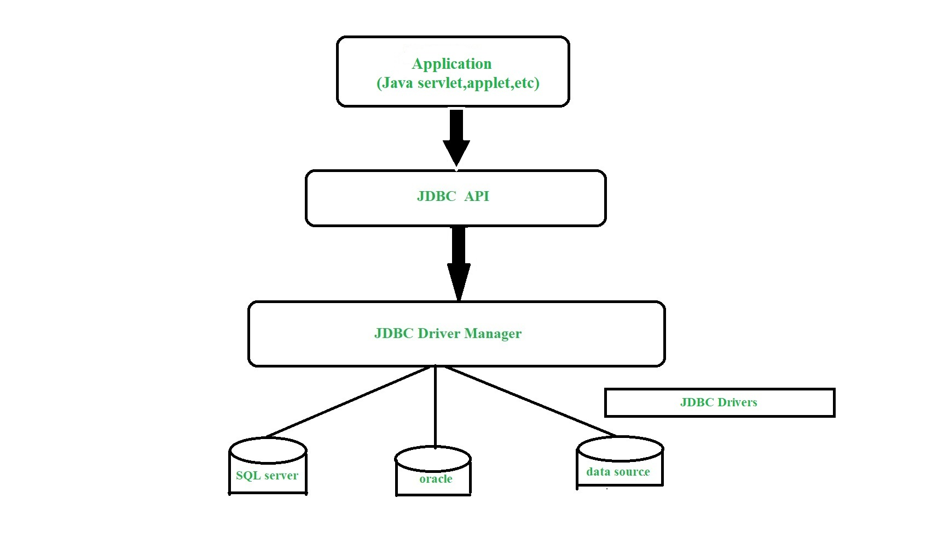

Slide 8
What is API?
API stands for Application Programming Interface. It is essentially a set of rules and protocols which transfers data between different software applications and allow different software applications to communicate with each other.
Through an API one application can request information or perform a function from another application without having direct access to it’s underlying code or the application data.
JDBC API uses JDBC Drivers to connect with the database.

Slide 9
JDBC Drivers
JDBC drivers are client-side adapters (installed on the client machine, not on the server) that convert requests from Java programs to a protocol that the DBMS can understand. There are 4 types of JDBC drivers:
Type-1 driver or JDBC-ODBC bridge driver
Type-2 driver or Native-API driver (partially java driver)
Type-3 driver or Network Protocol driver (fully java driver)
Type-4 driver or Thin driver (fully java driver)
The most commonly used type is type 4, as it has the advantage of being platform-independent. Connecting directly to a database server provides better performance compared to other types.

Slide 10
Interfaces of JDBC API
A list of popular interfaces of JDBC API is given below:
Driver interface
Connection interface
Statement interface
PreparedStatement interface
CallableStatement interface
ResultSet interface
ResultSetMetaData interface
DatabaseMetaData interface
RowSet interface

Slide 11
Classes of JDBC API
A list of popular classes of JDBC API is given below:
DriverManager class
Blob class
Clob class
Types class

Slide 12
Working of JDBC
Java application that needs to communicate with the database has to be programmed using JDBC API. JDBC Driver supporting data sources such as Oracle and SQL server has to be added in java application for JDBC support which can be done dynamically at run time.
This JDBC driver intelligently communicates the respective data source.

Slide 13
Connecting to a Database
To connect to a database, we simply have to initialize the driver and open a database connection.
1. Registering the Driver
For our example, we will use a type 4 database protocol driver.
Since we’re using a MySQL database, we need the mysql-connector-java dependency:
Next, let’s register the driver using the Class.forName() method, which dynamically loads the driver class:
In older versions of JDBC, before obtaining a connection, we first had to initialize the JDBC driver by calling the Class.forName method. As of JDBC 4.0, all drivers that are found in the classpath are automatically loaded. Therefore, we won’t need this Class.forName part in modern environments.

Slide 14
2. Creating the Connection
To open a connection, we can use the getConnection() method of DriverManager class. This method requires a connection URL String parameter:
try (Connection con = DriverManager
.getConnection("jdbc:mysql://localhost:3306/myDb", "user1", "pass")) {
// use con here
}
Since the Connection is an AutoCloseable resource, we should use it inside a try-with-resources block.
The syntax of the connection URL depends on the type of database used. Let’s take a look at a few examples:
jdbc:mysql://localhost:3306/myDb?user=user1&password=pass
jdbc:postgresql://localhost/myDb
jdbc:hsqldb:mem:myDb

Slide 15
2nd cont..
To connect to the specified myDb database, we will have to create the database and a user, and add grant necessary access:
CREATE DATABASE myDb;
CREATE USER 'user1' IDENTIFIED BY 'pass';
GRANT ALL on myDb.* TO 'user1';

Slide 16
Executing SQL Statements
The send SQL instructions to the database, we can use instances of type Statement, PreparedStatement, or CallableStatement, which we can obtain using the Connection object.
Statement
The Statement interface contains the essential functions for executing SQL commands.
First, let’s create a Statement object:
try (Statement stmt = con.createStatement()) {
// use stmt here
}
Again, we should work with Statements inside a try-with-resources block for automatic resource management.
Anyway, executing SQL instructions can be done through the use of three methods:
executeQuery() for SELECT instructions
executeUpdate() for updating the data or the database structure
execute() can be used for both cases above when the result is unknown

Slide 17
Cont…
Let’s use the execute() method to add a students table to our database:
String tableSql = "CREATE TABLE IF NOT EXISTS employees"
+ "(emp_id int PRIMARY KEY AUTO_INCREMENT, name varchar(30),"
+ "position varchar(30), salary double)";
stmt.execute(tableSql);

Slide 18
Cont..
When using the execute() method to update the data, then the stmt.getUpdateCount() method returns the number of rows affected.
If the result is 0 then either no rows were affected, or it was a database structure update command.
If the value is -1, then the command was a SELECT query; we can then obtain the result using stmt.getResultSet().
Next, let’s add a record to our table using the executeUpdate() method

Slide 19
CallableStatement
To create a CallableStatement object, we can use the prepareCall() method of Connection:
String preparedSql = "{call insertEmployee(?,?,?,?)}";
try (CallableStatement cstmt = con.prepareCall(preparedSql)) {
// use cstmt here
}
Setting input parameter values for the stored procedure is done like in the PreparedStatement interface, using setX() methods:
cstmt.setString(2, "ana");
cstmt.setString(3, "tester");
cstmt.setDouble(4, 2000);

Slide 20
Example
// Load driver class
Class.forName(driverClassName);
// Obtain a connection
Connection con = DriverManager.getConnection(
url, username, password);
// Obtain a statement
Statement st = con.createStatement();
// Execute the query
int count = st.executeUpdate(query);
System.out.println(
"number of rows affected by this query= "
+ count);
// Closing the connection as per the
// requirement with connection is completed
con.close();
}
} // class
import java.sql.*;
public class JDBCDemo {
public static void main(String args[])
throws SQLException, ClassNotFoundException
{
String driverClassName
= "sun.jdbc.odbc.JdbcOdbcDriver";
String url = "jdbc:odbc:XE";
String username = "scott";
String password = "tiger";
String query
= "insert into students values(109, 'bhatt')";

Slide 21
Java Database Connectivity with Oracle
To connect java application with the oracle database, we need to follow 5 following steps. In this example, we are using Oracle 10g as the database. So we need to know following information for the oracle database: Driver class: The driver class for the oracle database is oracle.jdbc.driver.OracleDriver.
Connection URL: The connection URL for the oracle10G database is jdbc:oracle:thin:@localhost:1521:xe where jdbc is the API, oracle is the database, thin is the driver, localhost is the server name on which oracle is running, we may also use IP address, 1521 is the port number and XE is the Oracle service name. You may get all these information from the tnsnames.ora file.
Username: The default username for the oracle database is system.
Password: It is the password given by the user at the time of installing the oracle database.

Slide 22
Create a Table
Before establishing connection, let's first create a table in oracle database. Following is the SQL query to create a table.
create table emp(id number(10),name varchar2(40),age number(3));
Example
The following example creates a table called "Persons" that contains five columns: PersonID, LastName, FirstName, Address, and City:
CREATE TABLE Persons (
PersonID int,
LastName varchar(255),
FirstName varchar(255),
Address varchar(255),
City varchar(255)
);

Slide 23
CREATE TABLE
Syntax
CREATE TABLE table_name (
column1 datatype,
column2 datatype,
column3 datatype,
....
);

Slide 24
Insert Data into Table
To add data to the table, we use INSERT INTO, the syntax is as shown below:
Insert into Table_name(Column1, Column2, Column3)
Values (Value1, value2, value3);
-- Insert some sample data into the Customers table
INSERT INTO Customer (CustomerID, CustomerName, LastName, Country, Age, Phone)
VALUES (1, 'Shubham', 'Thakur', 'India','23','xxxxxxxxxx'),
(2, 'Aman ', 'Chopra', 'Australia','21','xxxxxxxxxx'),
(3, 'Naveen', 'Tulasi', 'Sri lanka','24','xxxxxxxxxx'),
(4, 'Aditya', 'Arpan', 'Austria','21','xxxxxxxxxx'),
(5, 'Nishant. Salchichas S.A.', 'Jain', 'Spain','22','xxxxxxxxxx');

Slide 25
import java.sql.*;
class OracleCon{
public static void main(String args[]){
try{
//step1 load the driver class
Class.forName("oracle.jdbc.driver.OracleDriver");
//step2 create the connection object
Connection con=DriverManager.getConnection(
"jdbc:oracle:thin:@localhost:1521:xe","system","oracle");
//step3 create the statement object
Statement stmt=con.createStatement();
//step4 execute query
ResultSet rs=stmt.executeQuery("select * from emp");
while(rs.next())
System.out.println(rs.getInt(1)+" "+rs.getString(2)+" "+rs.getString(3));
//step5 close the connection object
con.close();
}catch(Exception e){ System.out.println(e);}
} }

